Slide 1



Seasons of Life
Conversations about sexual health, fertility & the perimenopause/menopause years
Dr Oge Ilozue, Mother’s day out brunch
Sunday 30th March 2025

Slide 2
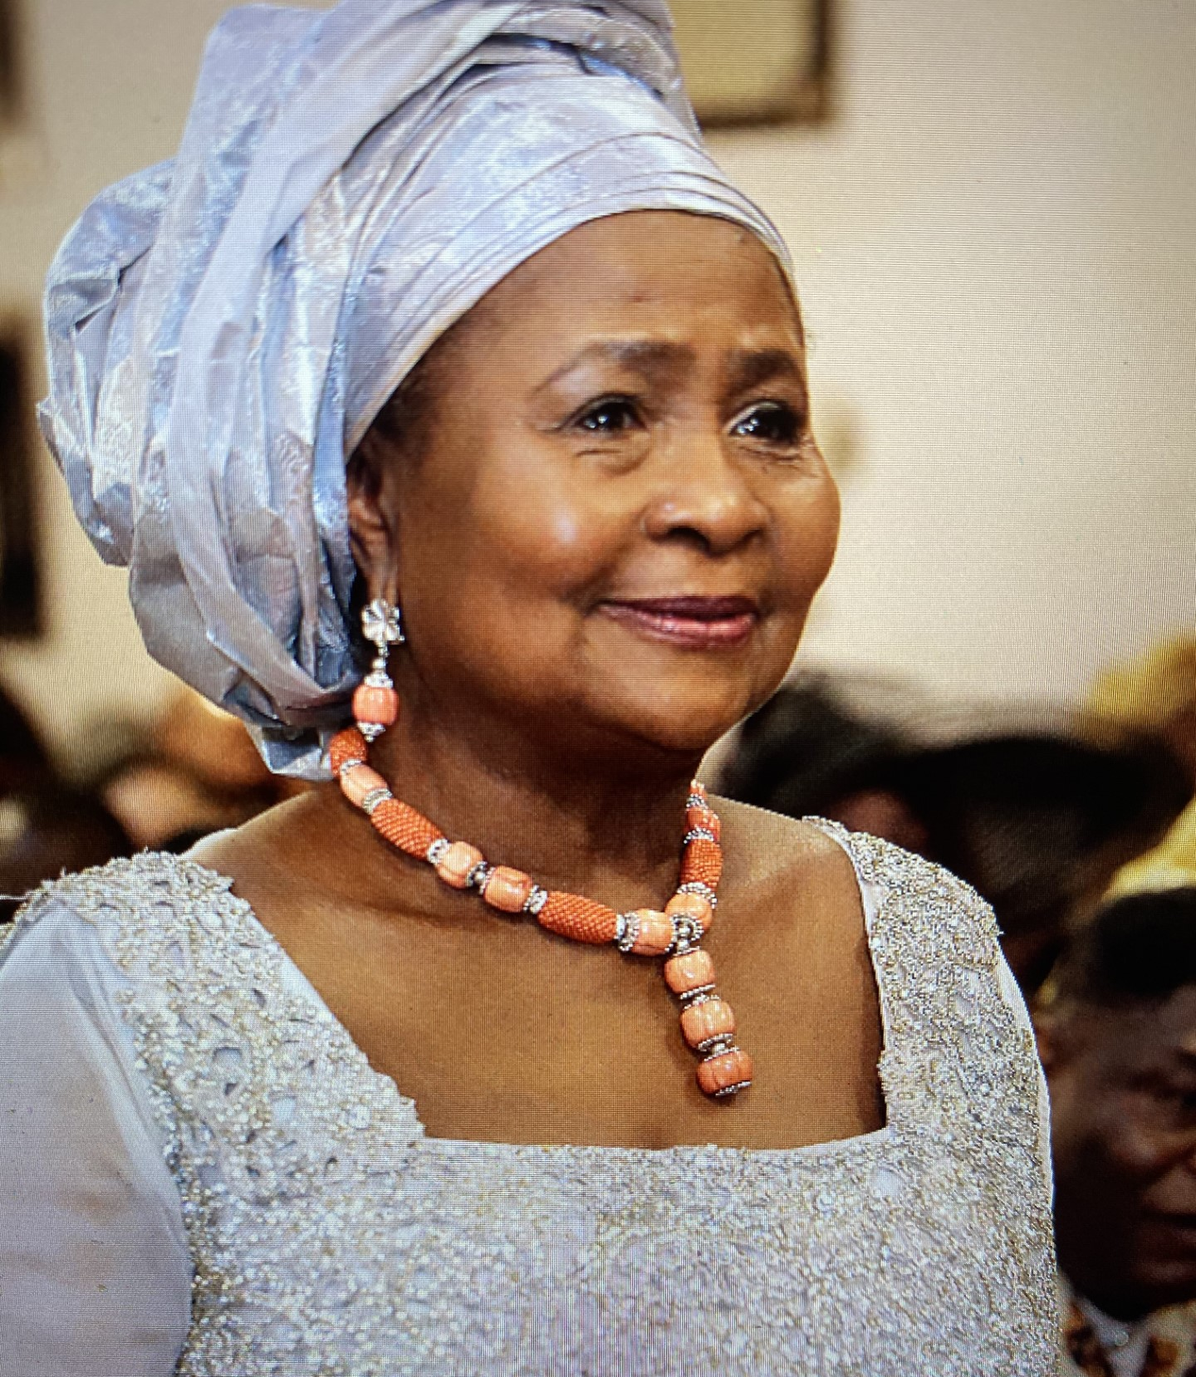
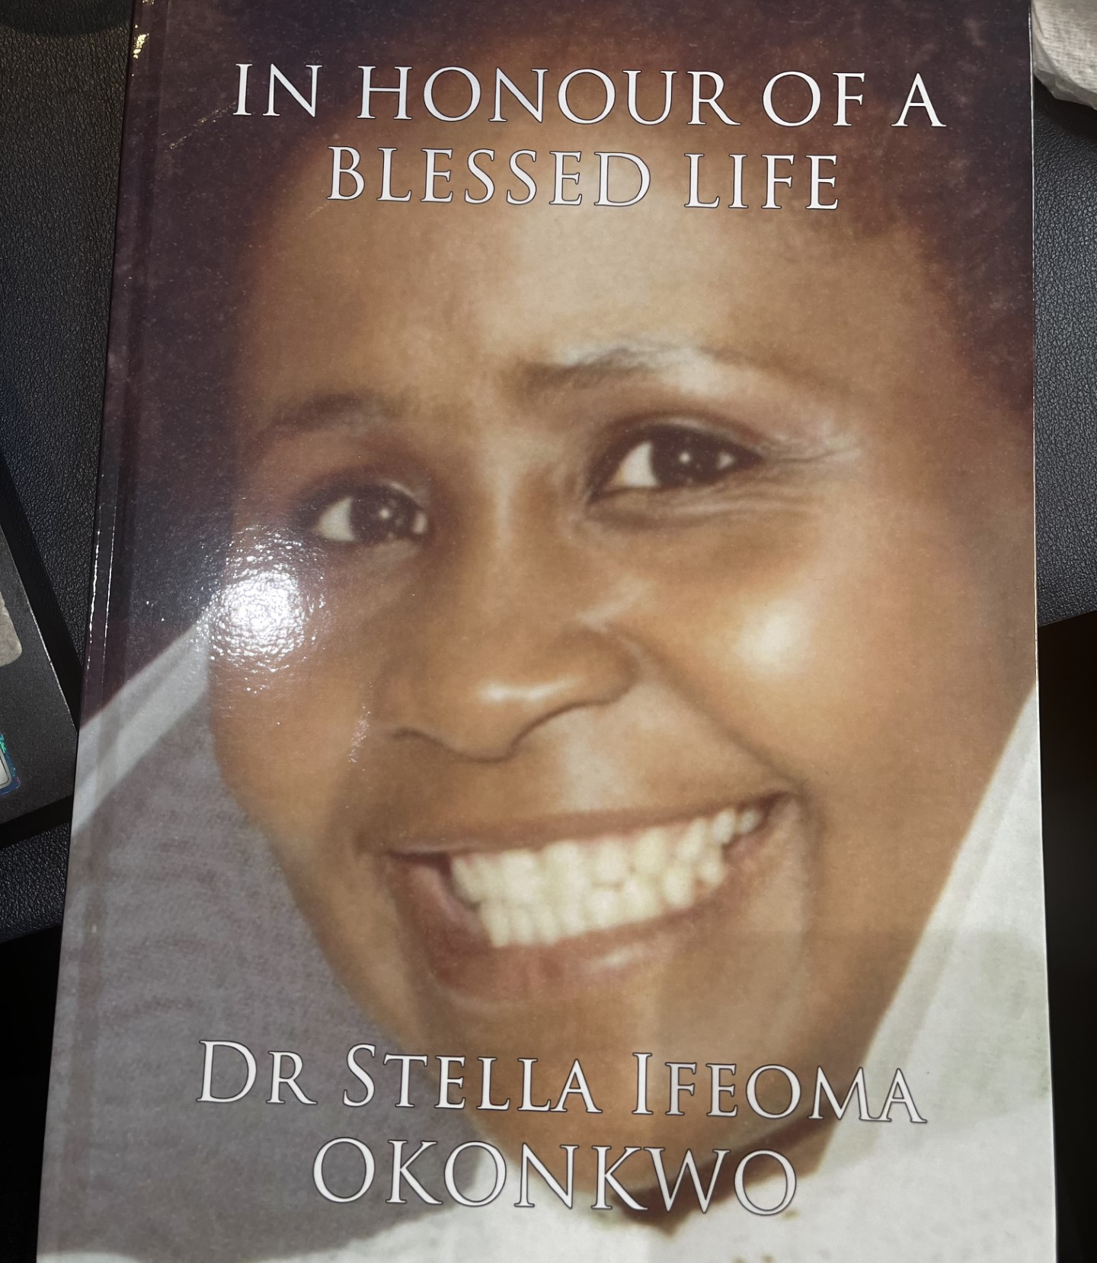

On this Mothering Sunday…….

Slide 3
Bright beginnings
Puberty
Menarche – start of periods
What is normal for a period?
Health Videos | Talks with Dr Sesay – It is never just a period! & Endometriosis
Premenstrual syndrome (PMS) and Premenstrual dysphoric disorder (PMDD)
Polycystic ovarian syndrome (PCOS)
Fibroids

Slide 4
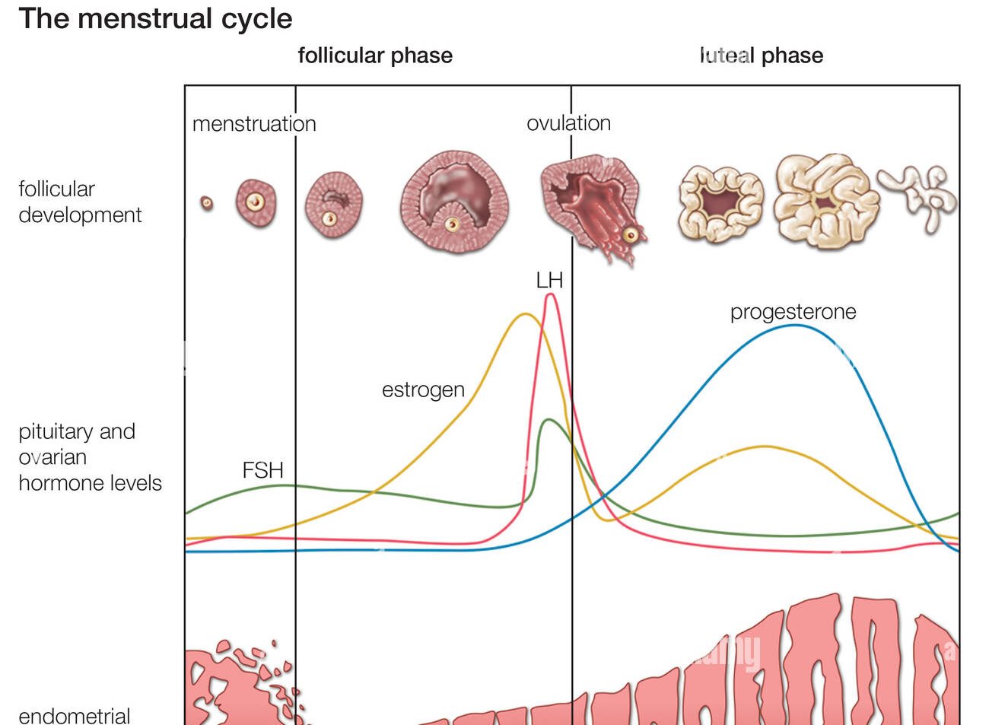
Periods
Know your cycle and the fluctuant nature of hormones during the menstrual cycle
Menstruation – 1st few days – rest, replace iron
Follicular phase – as oestrogen peaks, more energy
Ovulation – libido may increase
Luteal phase – 2nd half, less energy and mood changes

Slide 5
Sexual health
Culture and religious teachings
Celibacy
Exploration in a relationship
Contraception
Libido
Orgasm
Psychosexual therapy

Slide 6
Fertility
Estimate 1in 7 couples may have difficulties in conceiving
Male and female factors
Can be unexplained
Seek advice and help if not able to conceive after 1 year of trying, sooner if >35yrs

Slide 7


Pregnancy & Post partum period
Statistics in in UK and worldwide for Black women are sobering
Black women more likely to die in childbirth and in the year after childbirth than white women
Multifactorial reasons – systemic racism, long term conditions, awareness
Once we know better, we must do better
Domestic violence – this period can put women at increased risk of this
The 4th trimester – Post partum depression & Adjustment after the birth

Slide 8
Perimenopause & Menopause
Average age of menopause in the UK is 51yrs (1yr after last period)
Black women may experience this earlier – 49yrs
Perimenopause can be 10-15yrs before periods fully stop
Hormones (oestrogen and progesterone mainly) can change unpredictably
Some features:
    Changes to periods
    Hot flushes / temperature regulation changes
    Sleep changes / disruption
    Weight gain
    Brain fog
    Libido changes

Slide 9
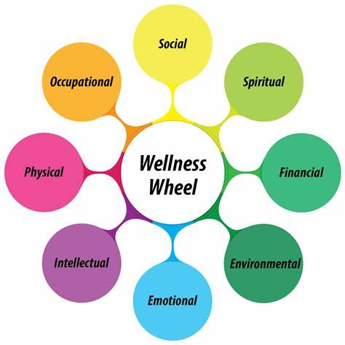
Solutions

Slide 10
Solutions
Look at your diet – we are what we are eating, and this is most of the battle
Movement – get walking!! weight training!! Get strong, build muscle, protect your heart
Prevention - Get your screening and vaccinations
Do you have a long term condition? Have you been for your NHS health check, have you had a cardiovascular health assessment?
Hormone therapy – can be a game changer for many – get informed and try it. No need for suffering and smiling!
Stress management – manage cortisol, sleep better, make those changes you want to in your life, seek therapy, build a supportive community around you – our network is our net worth

Slide 11
Breast self examination
https://youtube.com/shorts/FLn3PGzymDM?feature=shared
Talks with Dr Sesay
Breast screening invite from 50-71yrs every 3 years
Go and see your GP if you notice any abnormalities in-between
Self examine each month
Know your normal

Slide 12
Smear tests explained
https://youtube.com/shorts/FLn3PGzymDM?feature=shared
@drsimiadedeji
Every 3 years between 25-50yrs if normal
Every 5 years between 50-65yrs
If you experience any abnormal bleeding, discharge or pain – seek help before your screening invite

Slide 13


Thank you for listening
Let us keep talking!
@drochukwu
Dr Oge Ilozue

